Slide 1
Identifying Suspicious URLs
An Application of Large-Scale Online Learning
Vasu Jain
40057063

Slide 2
Motivation
The Web has long become a major platform for online criminal activities. URLs are used as the main vehicle in this domain. Today millions of rogue Web sites advance a wide variety of scams including marketing counterfeit goods (e.g., pharmaceuticals or luxury watches), perpetrating financial fraud (e.g., “phishing”) and propagating malware (e.g., via “drive-by” exploits or social engineering).
Thus, surfing online comes with its on risks. Each time a user has to open a previously unseen URL, he has to evaluate the risks associated with the same.
There are some online websites available where a user can input a web URL and get the data regarding if it is malicious or not. But it is impractical for these web applications to be up-to date with the constant addition of new malicious websites on a daily basis.
Thus, the aim is to develop a technique of marking any suspicious URL whether it is malicious or not based on the learning from the features of the previously identified malicious URLs.
Previous Works – In contrast to numerous works done on identification of suspicious URLs the motivation of the current work involves:
High feature set as compared to previous works.
Online learning as compared to batch learning.

Slide 3
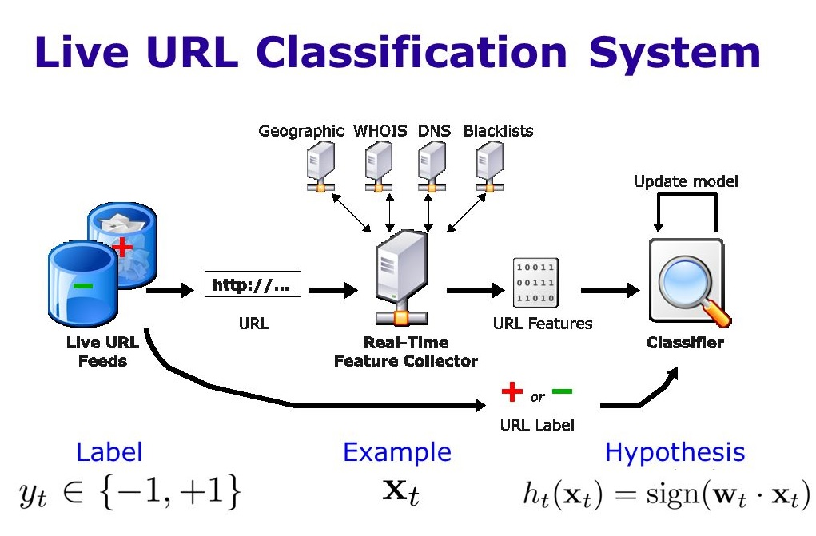
Data Pre-processing
The data set is collected from various online sources which supplies list of malicious URLs. Combining them with a list of benign ones we will get a list of classified URLs. Major URL sources is mentioned at the end of the slides.
We need to extract the lexical and host-based features of the given classified URLs and then analyse both the types of features to finally create a rule for classification using certain machine learning algorithm.

Slide 4
Lexical Features
Lexical means relating to words or text in the URLs as in this case.
These features allow us to capture the property that malicious URLs tend to “look different” from benign URLs.
For example: TLD(Top level domain) ‘org’ in www.abc.org seems legitimate. But the same in xyz.ca/www.abc.org might be an attempt of spoofing the original website.
So, the URL is analysed for presence of various keywords or special characters.
To implement these features, we use a bag-of-words representation of tokens in the URL, where ‘/’, ‘?’, ‘.’, ‘=’, ‘-’, and ‘ ’ are delimiters.
The lengths of the hostname and index path in the URL is also captured along with the other features and tokens present in the URL.

Slide 5
Host-Based features
These features describe properties of the Web site host as identified by the hostname portion of the URL. They allow us to approximate “where” malicious sites are hosted, “who” own them, and “how” they are managed.
Following are some of the properties that are analysed to extract the Host-based features:
WHOIS – It provides with a lot of information regarding a URL like registration dates, registrar, expiration date, hosting server information etc. which can be useful in generalizing about a URL. For example: We can generalize if a set of malicious URLs are registered to a particular registrar then we can consider the chances of a new URL registered with the same registrar as malicious.
Location Information – This is the host’s geography, IP address etc. A specific IP prefix in which a URL is hosted can provide the information about the all the sites hosted in that particular host.
Online website Rankings – We can use the online URL ranking engine such as Alexa to see and compare the rank of a given URL worldwide to see if the link is present in the ranking database of the engine.

Slide 6
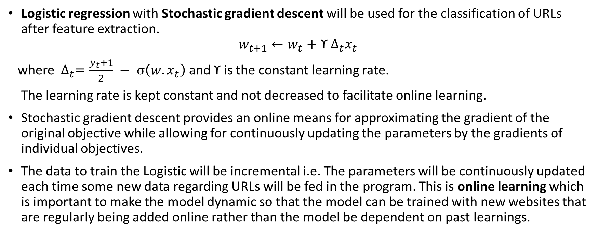
Learning Algorithm
Logistic regression with Stochastic gradient descent will be used for the classification of URLs after feature extraction.
$$w_{t+1}{←w}_{t}+{ \text{ϒ} Δ}_{t}x_{t}$$
where ${ Δ}_{t}=\frac{y_{t}+1}{2} − σ\left(w.x_{t}\right)$ and $\text{ϒ}$ is the constant learning rate.
The learning rate is kept constant and not decreased to facilitate online learning.
Stochastic gradient descent provides an online means for approximating the gradient of the original objective while allowing for continuously updating the parameters by the gradients of individual objectives.
The data to train the Logistic will be incremental i.e. The parameters will be continuously updated each time some new data regarding URLs will be fed in the program. This is online learning which is important to make the model dynamic so that the model can be trained with new websites that are regularly being added online rather than the model be dependent on past learnings.

Slide 7
References
For the Process
Identifying Suspicious URLs: An Application of Large-Scale Online Learning, by Justin Ma, Lawrence K. Saul, Stefan Savage and Geoffrey M. Voelker.
For the dataset
http://apac.trendmicro.com/apac/security-intelligence/current-threat-activity/malicious-top-ten/
https://www.phishtank.com/phish_archive.php
For the ranking of sites
https://www.alexa.com

